Slide 1
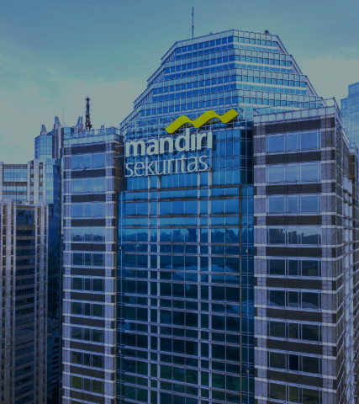
Data Engineer Recruitment Technical Test by Mandiri Sekuritas
Prepared by : Erina Rifka Simanjuntak
Technical Test by Mandiri Sekuritas
2025

Slide 2
TECHNICAL CASE 1
Import CRM tables into PostgreSQL and Summary

Slide 3
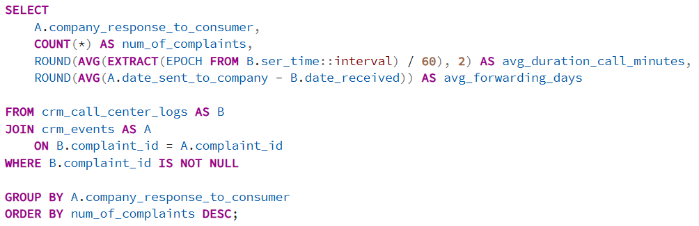
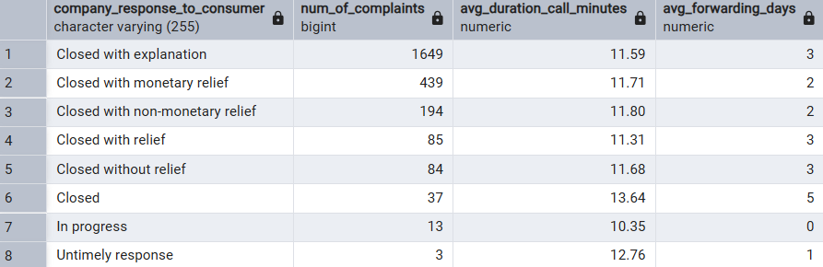
TECHNICAL CASE 1
Most complaints are in the ‘Closed with explanation’ category, totaling 1.649 complaints,
with an average forwarding time of 3 days and average call duration of 11.59 minutes.

Slide 4
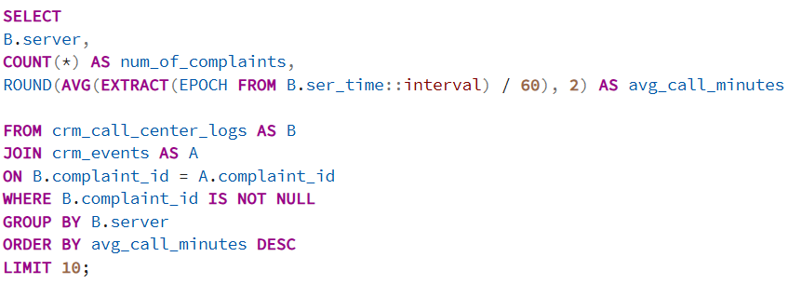
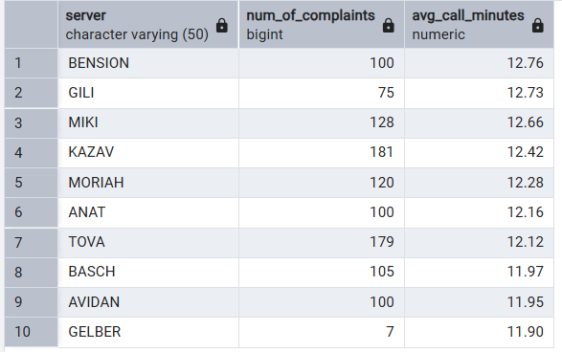
TECHNICAL CASE 1
Among the server (service agents), server Bension shows the longest average call duration
Averaging 12.76 minutes with 100 complaints handled.

Slide 5
TECHNICAL CASE 2
Luxury Loan Portfolio Dashboard

Slide 6
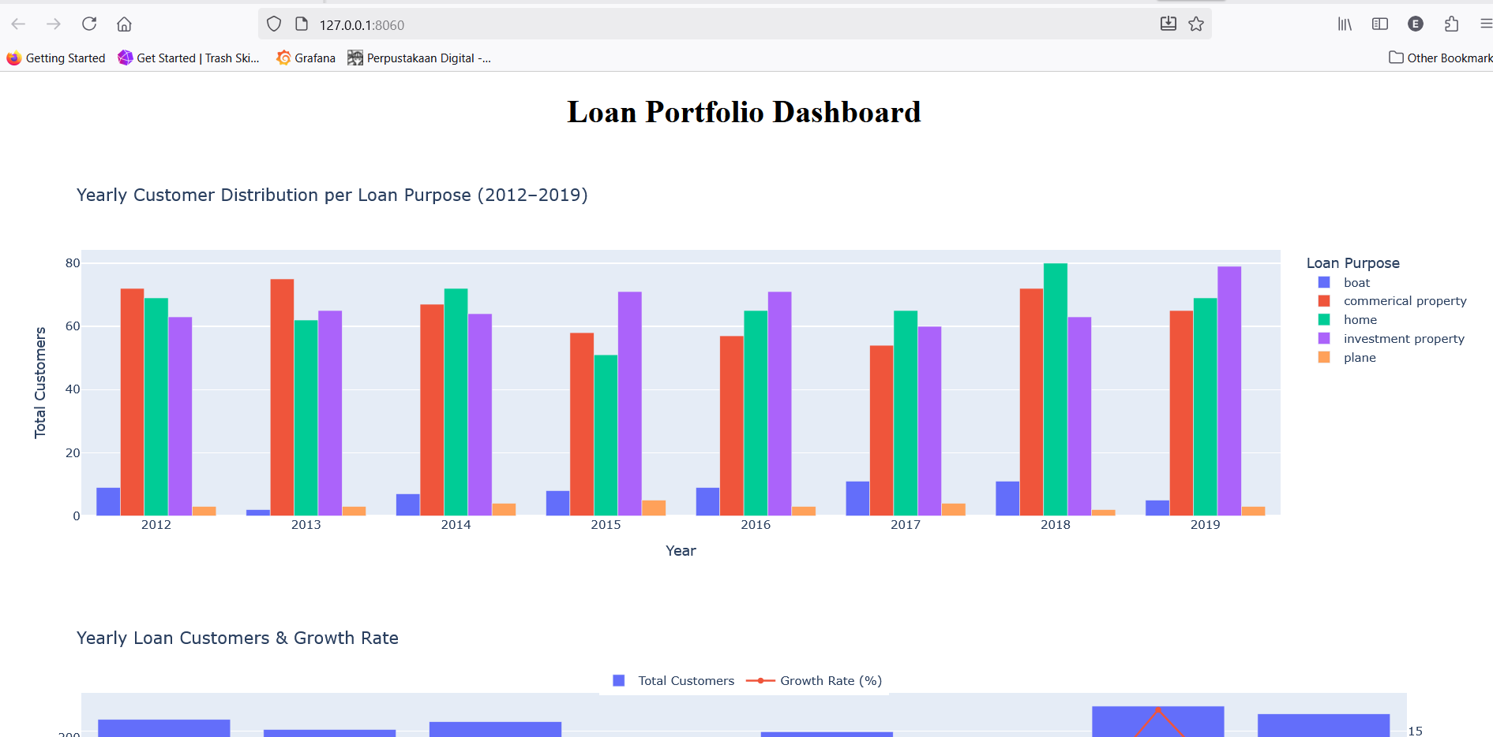
TECHNICAL CASE 2
View when opening the web portal :

Slide 7
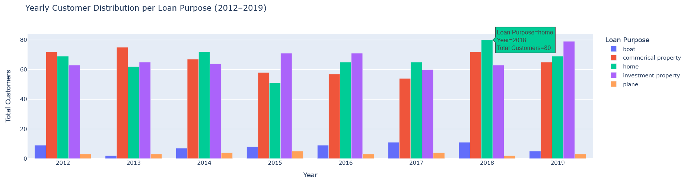
TECHNICAL CASE 2
Dashboard 1
1. Top 3 loan purposes (2012–2019) by number of customers:
Commercial property
Home
Investment property
2. The highest number of customers was recorded for home loans in 2018, with total customers is 80 customers

Slide 8
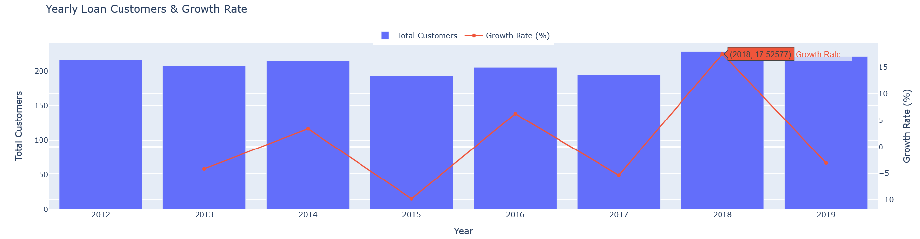
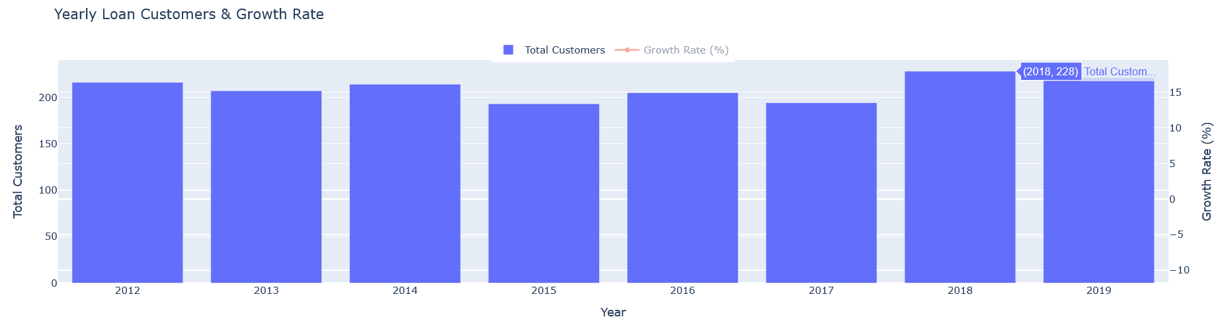
TECHNICAL CASE 2
Dashboard 2
The highest number of customers was from 2018 with 228 customers
The highest growth rate was from 2018 with percentage 17,52%

Slide 9
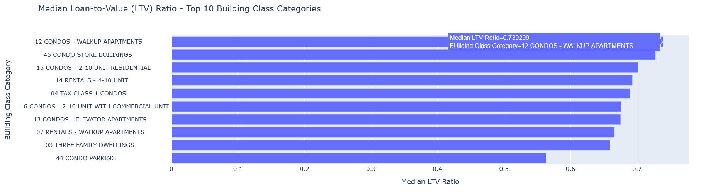
TECHNICAL CASE 2
Dashboard 3
The most frequently chosen building class category is 12 Condos – Walkup Apartments, with an LTV ratio of 0.74.
Loan-to-Value (LTV) = Loan balance ÷ Property value
A higher LTV means greater risk (loan amount closer to property value)
A lower LTV means safer loan (larger equity/down payment from borrower)

Slide 10
TECHNICAL CASE 3
How to create LLM chat using only internal database?

Slide 11
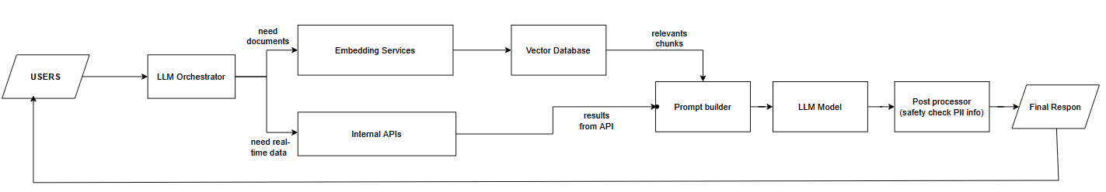
TECHNICAL CASE 3
User mengajukan pertanyaan ke chatbot.
Orchestrator akan analisis pertanyaan.
Jika butuh informasi dari dokumen → diteruskan ke Embedding Service → query ke Vector Database untuk cari dokumen paling relevan.
Jika butuh data real-time (misalnya status transaksi, HR, CRM) → diteruskan ke Internal API.
Prompt Builder : Menggabungkan hasil retrieval (dokumen + data API) dengan pertanyaan user ke dalam satu konteks.
LLM Model : Memberi jawaban berbasis konteks internal.
Post-Processor: Pengecekan keamanan, menyaring PII, dan memastikan jawaban sesuai aturan.
Response dikirim kembali ke user,
Feedback user akan digunakan untuk evaluasi

Slide 12
TECHNICAL CASE 4
How to create data platform end-to-end system?

Slide 13
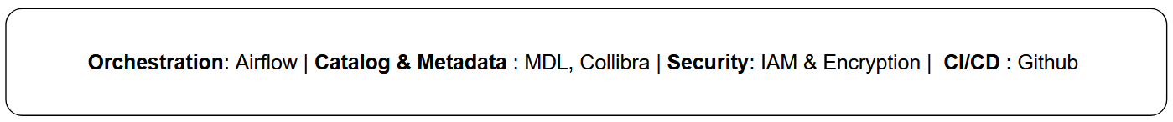
TECHNICAL CASE 4
Sources Data : Data comes from files, databases, APIs, or streaming sources.
Data Ingestion : Tools like Dataflow or AWS Kinesis capture and load the data.
Data Lake : Raw data is stored in scalable storage like GCS or S3.
Data Processing : Processing engines such as Spark for cleaning, transforming, and preparing data.
Data Warehouse (curated data) :Transformed data is stored in BigQuery or Redshift for analytics.
Consumer : Users access the data, data can use in BI tools or Spark for reporting, data preparation, modelling
With supporting components include : Orchestration (Airflow), Catalog & Metadata (MDL, Collibra), Security (IAM & encryption), and CI/CD (GitHub).

Slide 14
TECHNICAL CASE 5
What is the future of fintech in investment banking?

Slide 15
TECHNICAL CASE 5
The future of fintech in investment banking will be shaped by digitalization that enhances efficiency across processes.
Big data and AI will accelerate risk analysis, valuation, and portfolio management while lowering costs, allowing bankers to focus on more strategic roles.
However, true competitiveness lies not only in efficiency but also in security. In banking, security is both a necessity and a strategic advantage that builds trust. The stronger the protection, the more attractive the bank becomes to clients. Efficiency keeps banks competitive, but security ensures long-term superiority.

